Slide 1
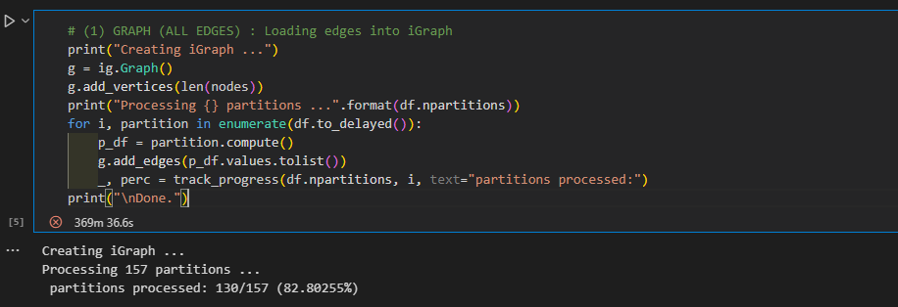

Slide 2
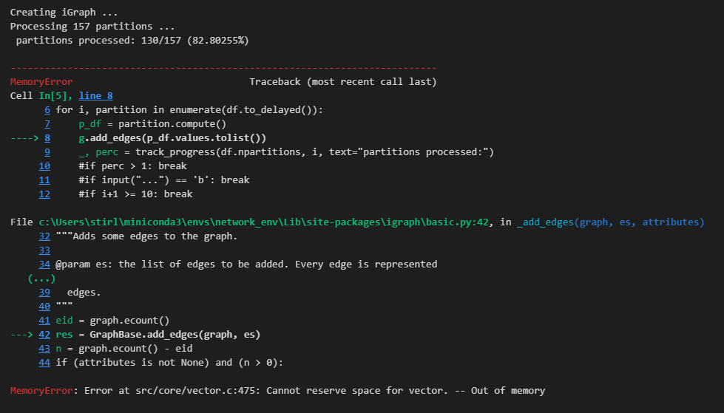

Slide 3
Project 8. Twitter COVID19 Network Analysis II
Matt Stirling

Slide 4
Dataset Description
Dataset: https://zenodo.org/records/3871753
Consider the TweetsCOV19 dataset, a semantically annotated corpus of Twitter about COVID19 aiming at capturing online discourse about various aspects of the pandemic and its social impact.

Slide 5
Project Specification

Slide 6
Graph construction description

Slide 7
Nature of the graph

